Slide 1
COMP2200 Presentation
Group 69 Members：
Ming Lin - 45958734 Mingxin Yang - 47088877
Ryan Parnell - 47088079 Joshua Johnston - 45934568

Slide 2
Problem Statement: What problem are you trying to solve?
Speaker: Ming Lin - 45958734
COVID-19 had major impact on every aspect of our lives.
Decision of lockdown, people have to stay at home
Drastically changed the data surrounding public transport in Australia
Locking at this change in data, it can provide insight into the impact of COVID-19 on the public transport system in Australia.
Project Goal:
To predict what would happen with bus trip data if there is no COVID-19

Slide 3

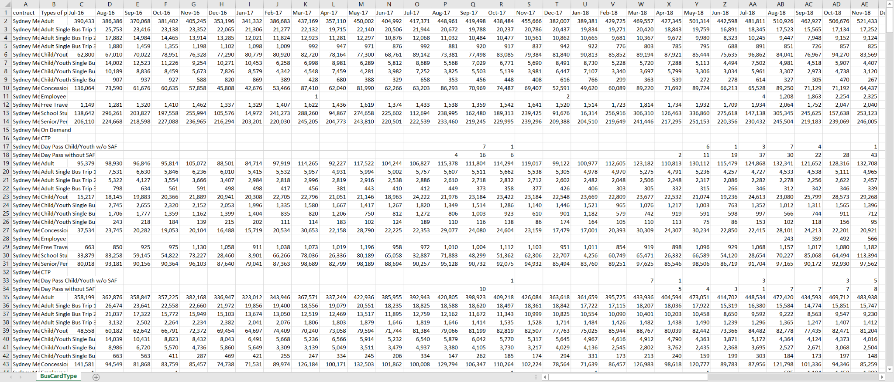
Data sources: What are the data sources you worked on this project
Speaker: Ming Lin - 45958734
Where the data comes from
Transport for NSW website
The Monthly Opal Bus Trips by Contract Area data

Slide 4
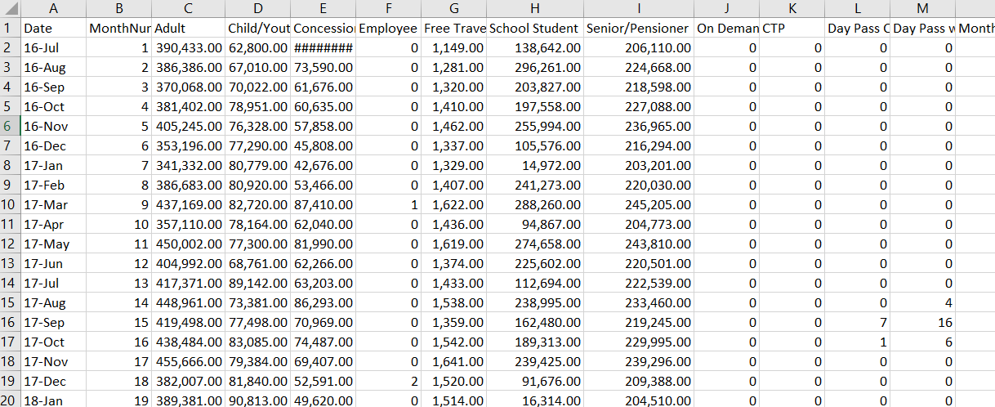
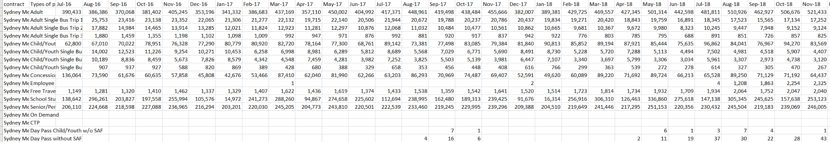
Data Source - Data clean
Speaker: Ming Lin - 45958734
Data cleaning
Only extract the relevant data we want focus on
Remove the less knowledgeable information
Reformate the data ( transposing the column titles and the row titles)

Slide 5
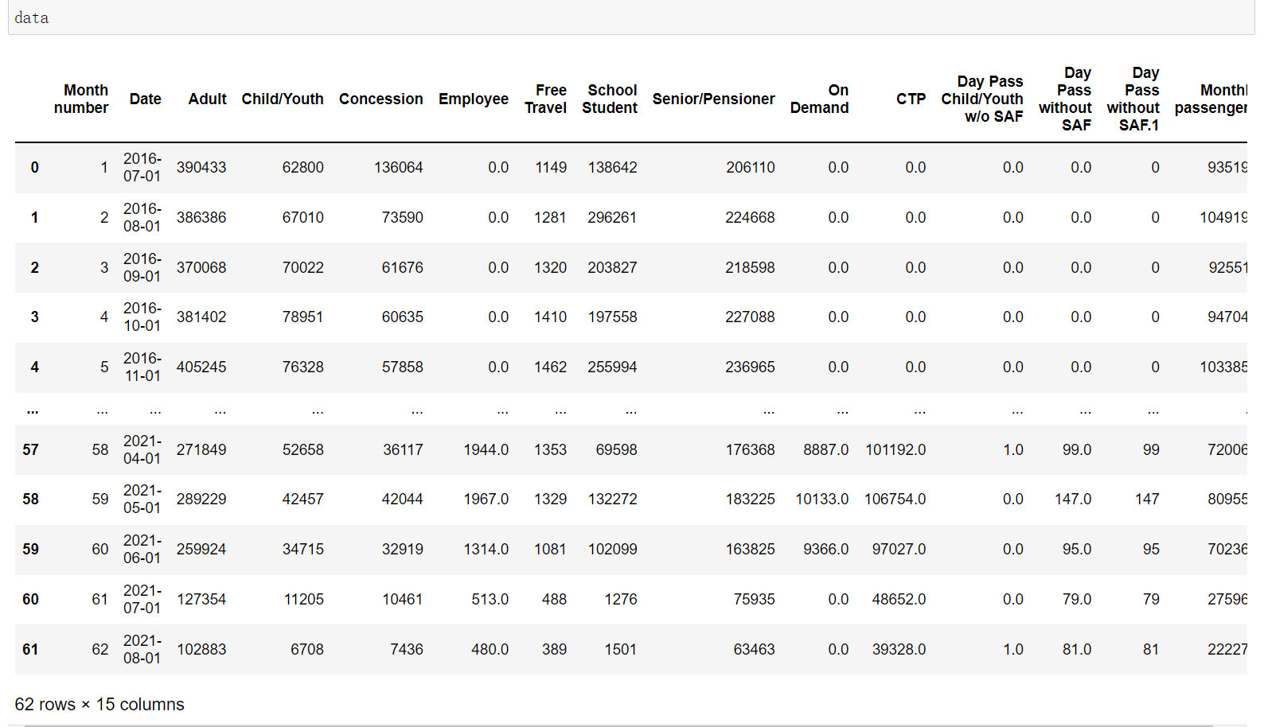
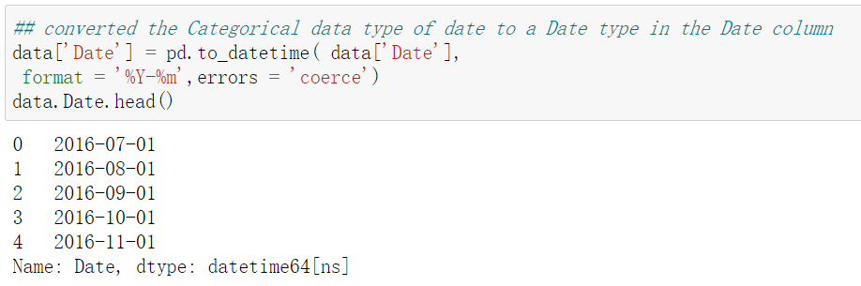
Data Source - Data clean
Speaker: Ming Lin - 45958734
Fill the null values with “0” value in
Converted the data type for “Date” column from String type to Date Type

Slide 6
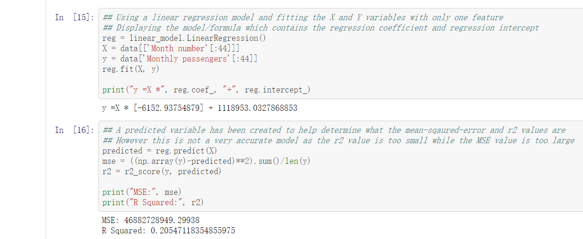
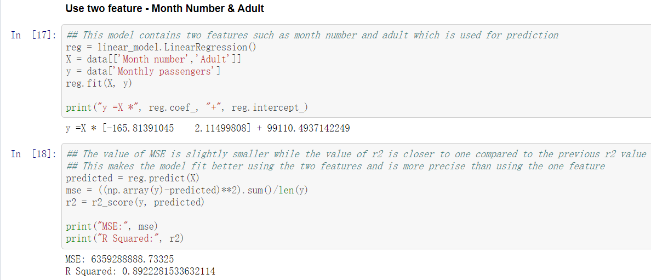
Methods Used: Linear Regression Speaker:Mingxin
------ Comparison of R2 values between using one feature and two features for predicting passengers number.
------ Using data before April 2020 only
------ Using only the Month Index:0.20547
------ Using two features including the Adult passenger number: 0.89223

Slide 7
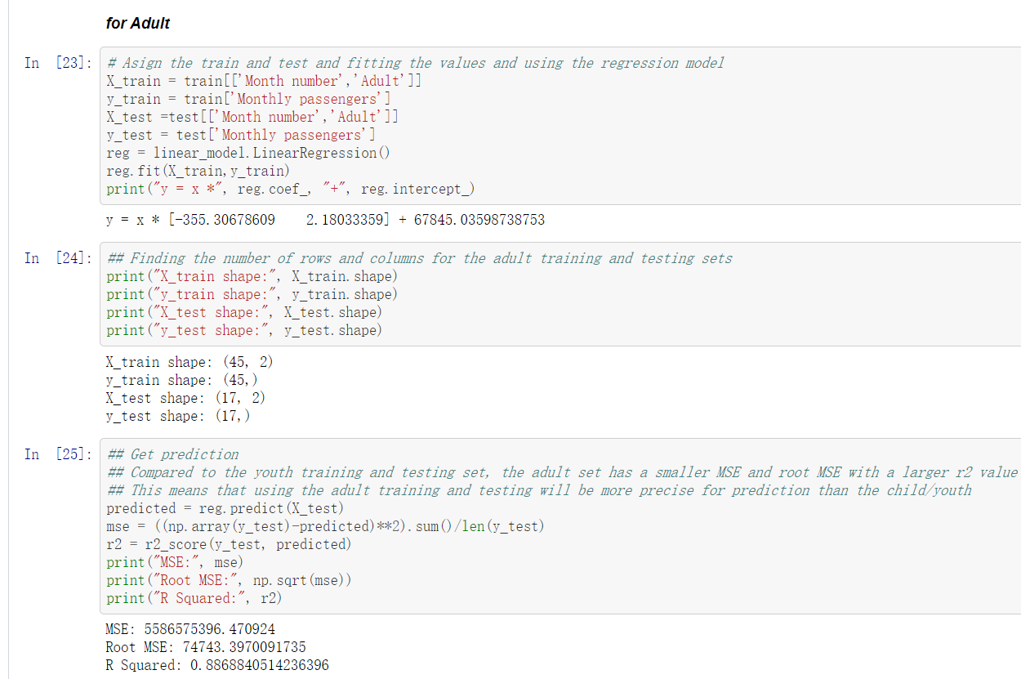
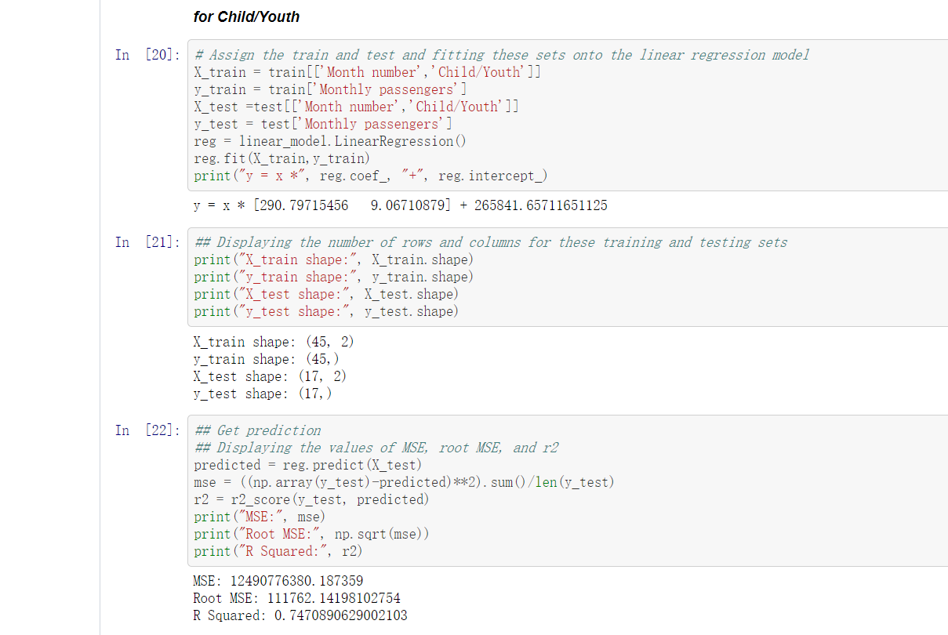
Linear Model Speaker:Mingxin
--- Using one type of passenger and the month index to predict the Total number of passengers
--- Child/Youth: Mostly students, which has a fluctuating trend due to holiday and semester break (R2 value:0.747)
--- Adult: less holiday>>>less fluctuation, consistent commute routine (R2 value:0.887)

Slide 8
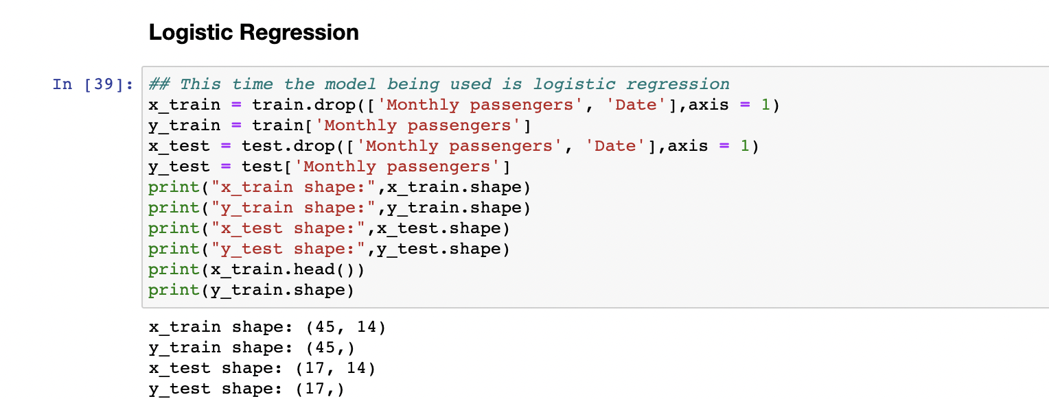
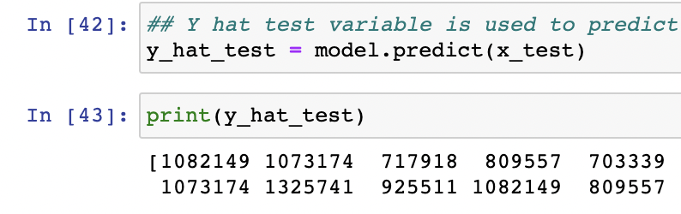
Logistic Regression
Speaker:Ryan
This is another model that is used to calculate the number of monthly passengers
Using X train, test and Y train, test to fit model and determine accuracy
Y hat test variable for predicting
This model should not be used as it has a poor accuracy

Slide 9
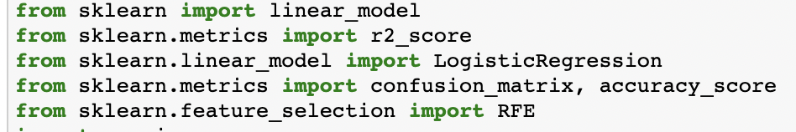
Results: What are your results? (Provide both Exploratory Data Analysis and results based on standard evaluation metrics)
Speaker: Ryan
From linear regression, there is a higher R squared value; this is more precise (adult/month number)
Unlike logistic regression which has an accuracy of 0.0
Linear model is better for prediction
Next slide shows accuracy and linear R-squared value

Slide 10
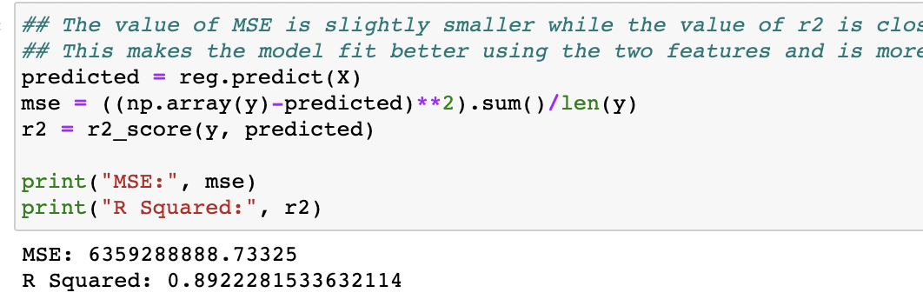
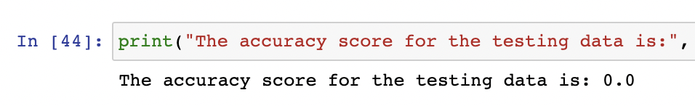
Model Results
Speaker: Ryan

Slide 11
Conclusion Speaker:Mingxin
--- Significant impacts on the number of passengers of Sydney Bus System
--- The trend of monthly passengers during covid-19 period stable and consistent,
--- Decrease of passengers in public transport sector, indicates a risk of contraction in the economy cycle
--- Less money would flow into the physical industry, which severely impacts tertiary industry, especially hospitality and education sectors.

Slide 12
Thank you for Watching~

